Slide 1


UMANG DOBHAL
22 JULY 2024

Slide 2

Outline
Executive Summary
Introduction
Methodology
Results
Conclusion
Appendix

Slide 3
Executive Summary
Summary of methodologies:
Data Collection: Web Scraping and SpaceX API
EDA: Data Wrangling, Data Visualization, Interactive Visual Analytics
Machine Learning Prediction
Summary of Results:
Data collected from public sources
EDA identified key features for launch success
Best model identified for predicting successful launches

Slide 4
Introduction
Project Background and Context
Objective: Evaluate the viability of SpaceY to compete with SpaceX
Key Questions:
Estimating total launch costs
Identifying best launch sites

Slide 5

Section 1

Slide 6
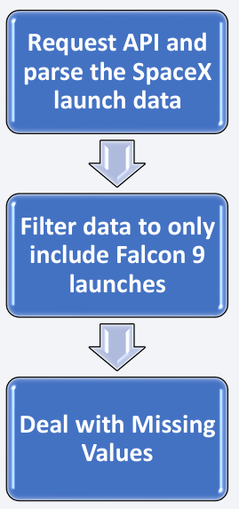
Data Collection
Methods
Data collection methods:
SpaceX API
Web Scraping
Flowchart of SpaceX API calls
Example URLs and GitHub links for reference notebooks

Slide 7
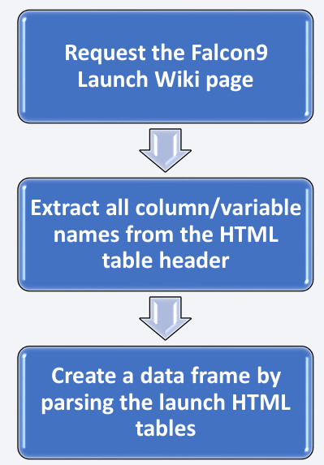
Data Collection - Scraping
Data from SpaceX launches can also be obtained from Wikipedia;
Data are downloaded from Wikipedia according to the flowchart and then persisted.

Slide 8
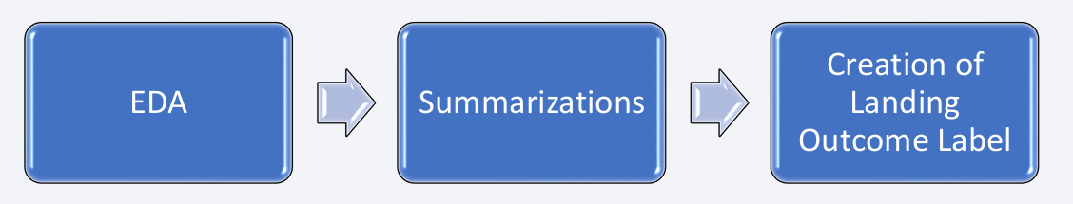
Data Wrangling
Initially some Exploratory Data Analysis (EDA) was performed on the dataset.
Then the summaries launches per site, occurrences of each orbit and occurrences of mission outcome per orbit type were calculated.
Finally, the landing outcome label was created from Outcome column.

Slide 9
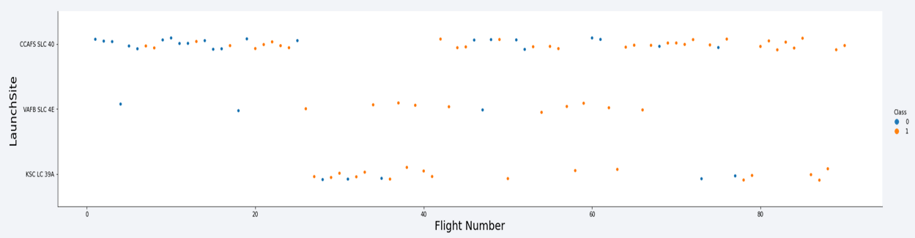
EDA with Data Visualization
To explore data, scatter plots and boxplots were used to visualize the relationship between pair of features.

Slide 10
EDA with SQL
The following SQL queries were performed:
Names of the unique launch sites in the space mission;
Top 5 launch sites whose name begin with the string 'CCA’;
Total payload mass carried by boosters launched by NASA (CRS);
Average payload mass carried by booster version F9 v1.1;
Date when the first successful landing outcome in ground pad was achieved;
Names of the boosters which have success in drone ship and have payload mass between 4000 and 6000 kg;
Total number of successful and failure mission outcomes;
Names of the booster versions which have carried the maximum payload mass;
Failed landing outcomes in drone ship, their booster versions, and launch site names for in year 2015; and
Rank of the count of landing outcomes (such as Failure (drone ship) or Success (ground pad)) between the date 2010-06-04 and 2017-03-20.

Slide 11
Build an Interactive Map with Folium
Markers, circles, lines and marker clusters were used with Folium Maps
Markers indicate points like launch sites;
Circles indicate highlighted areas around specific coordinates, like NASA Johnson Space Center;
Marker clusters indicates groups of events in each coordinate, like launches in a launch site; and
Lines are used to indicate distances between two coordinates.

Slide 12
Build a Dashboard with Plotly Dash
The following graphs and plots were used to visualize data •
Percentage of launches by site •
Payload range
This combination allowed to quickly analyze the relation between payloads and launch sites, helping to identify where is best place to launch according to payloads.

Slide 13
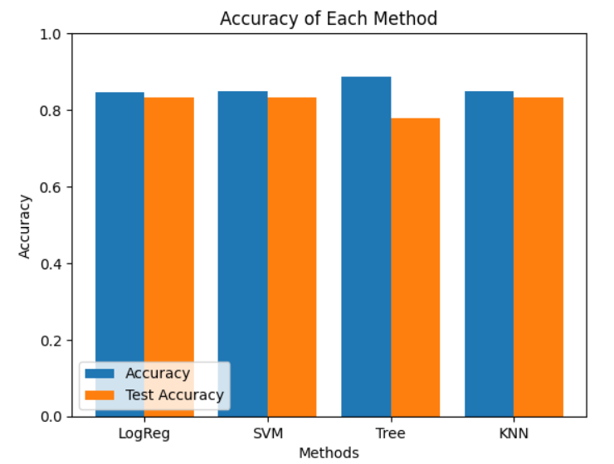
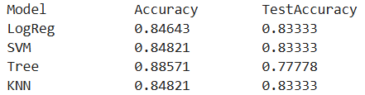
Predictive Analysis (Classification)
Four classification models were compared: logistic regression, support vector machine, decision tree and k nearest neighbors.

Slide 14
Results
Exploratory data analysis results:
Space X uses 4 different launch sites;
The first launches were done to Space X itself and NASA;
The average payload of F9 v1.1 booster is 2,928 kg;
The first success landing outcome happened in 2015 fiver year after the first launch;
Many Falcon 9 booster versions were successful at landing in drone ships having payload above the average;
Almost 100% of mission outcomes were successful;
Two booster versions failed at landing in drone ships in 2015: F9 v1.1 B1012 and F9 v1.1 B1015;
The number of landing outcomes became as better as years passed.

Slide 15

Section 2

Slide 16
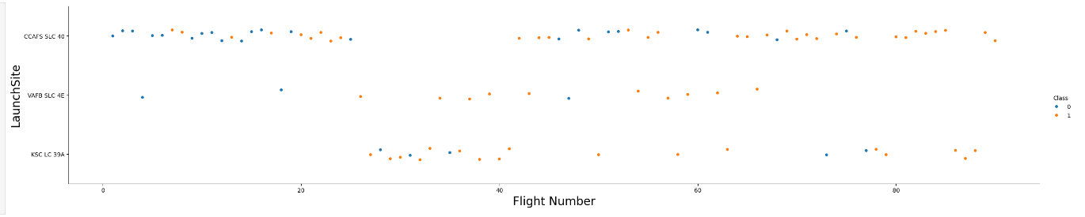
Flight Number vs. Launch Site

Slide 17
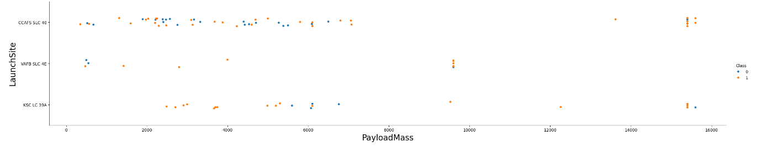
Payload vs. Launch Site

Slide 18
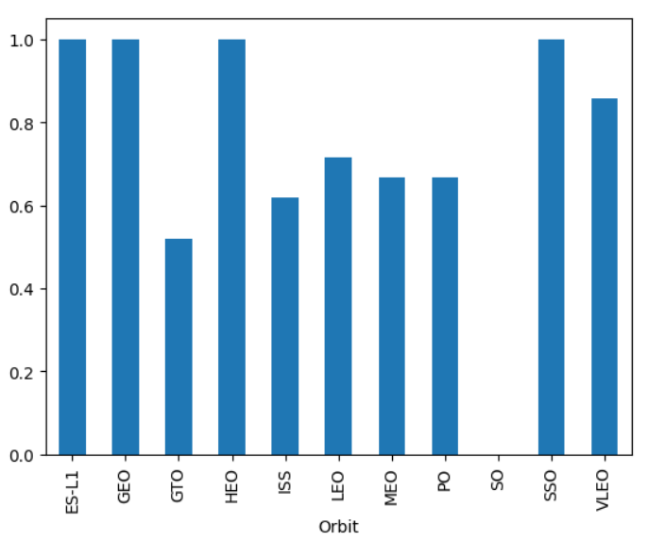
Success Rate vs. Orbit Type

Slide 19
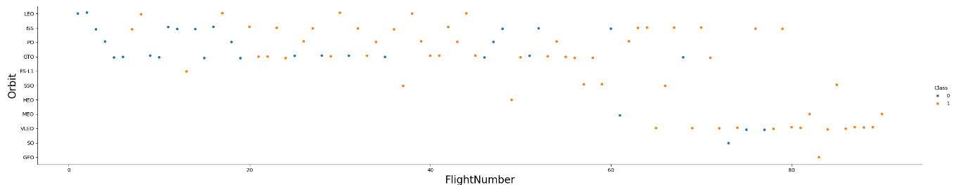
Flight Number vs. Orbit Type

Slide 20
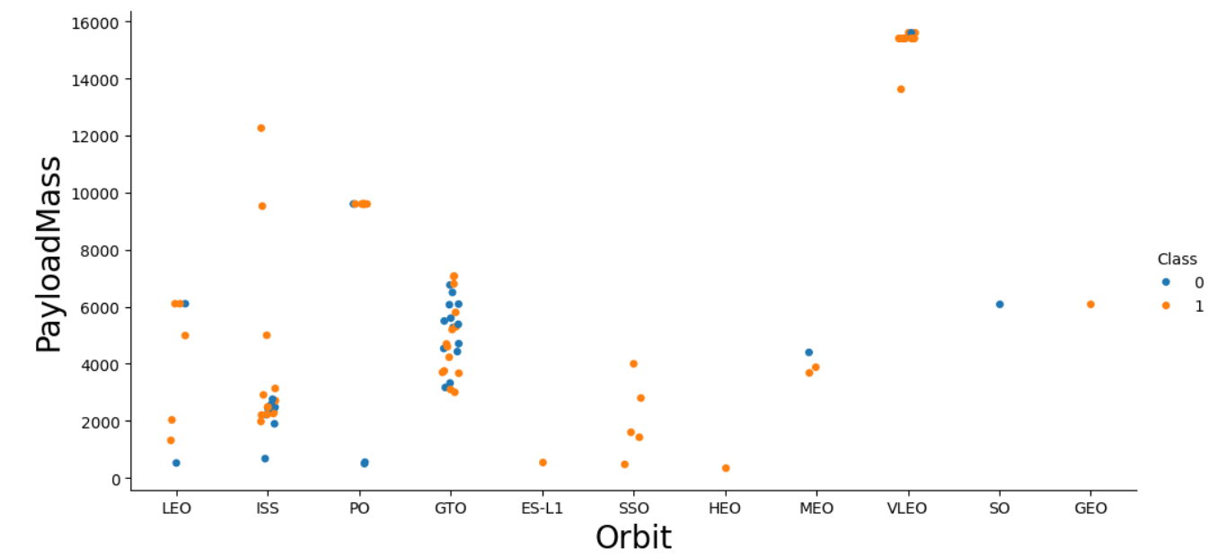
Payload vs. Orbit Type

Slide 21
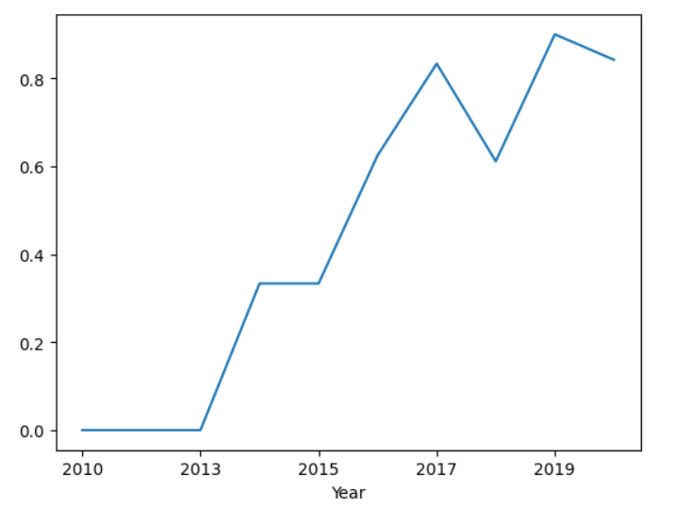
Launch Success Yearly Trend

Slide 22
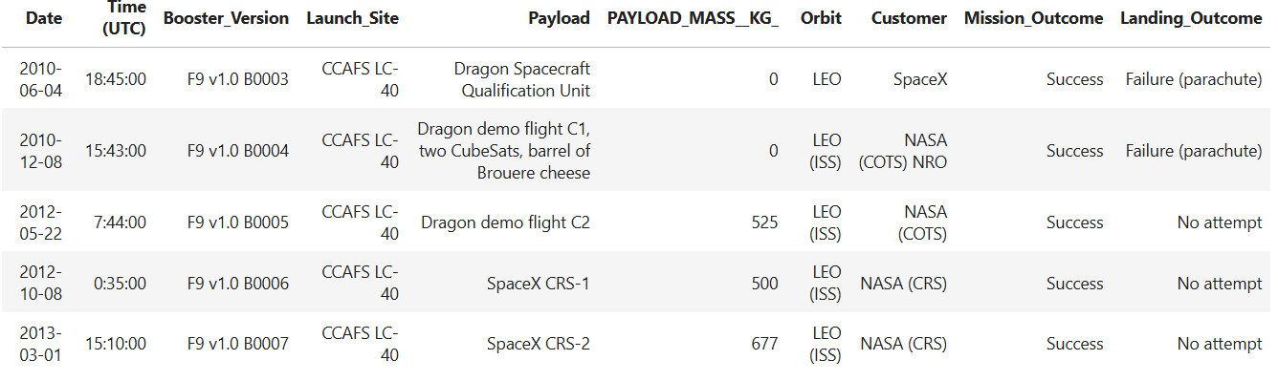
Launch Site Names Begin with 'CCA'

Slide 23
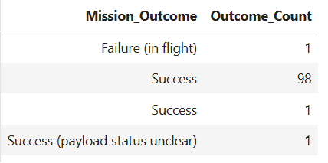
Total Number of Successful and Failure Mission Outcomes

Slide 24
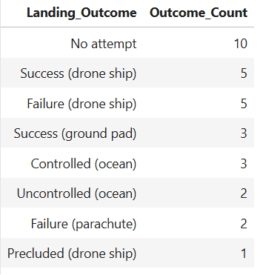
Rank Landing Outcomes Between 2010-06-04 and 2017-03-20

Slide 25

Section 3

Slide 26
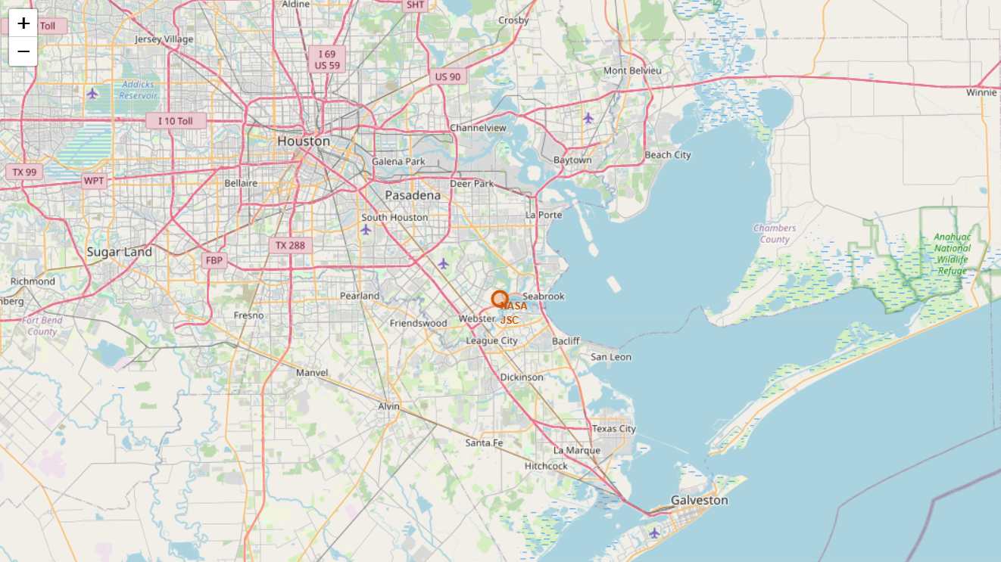
<Folium Map Screenshot 1>

Slide 27
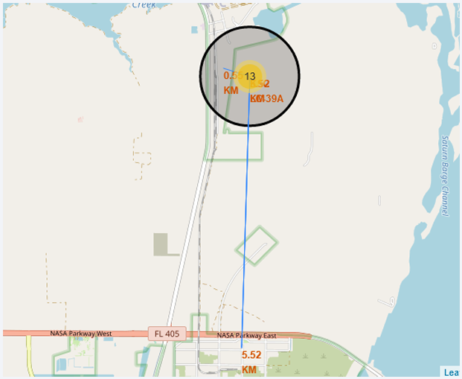
Logistic and Safety

Slide 28

Section 4

Slide 29
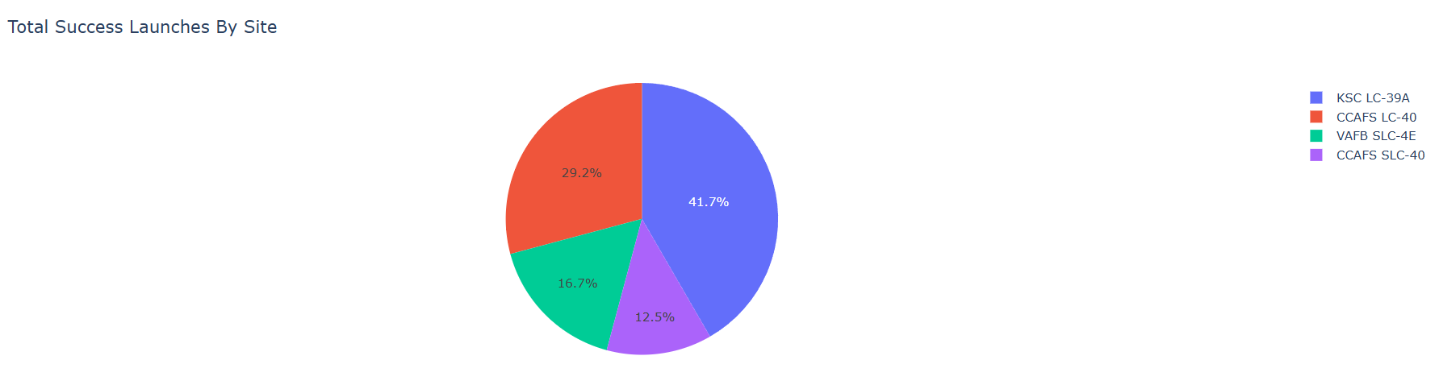
Pie Chart for Launch Success

Slide 30
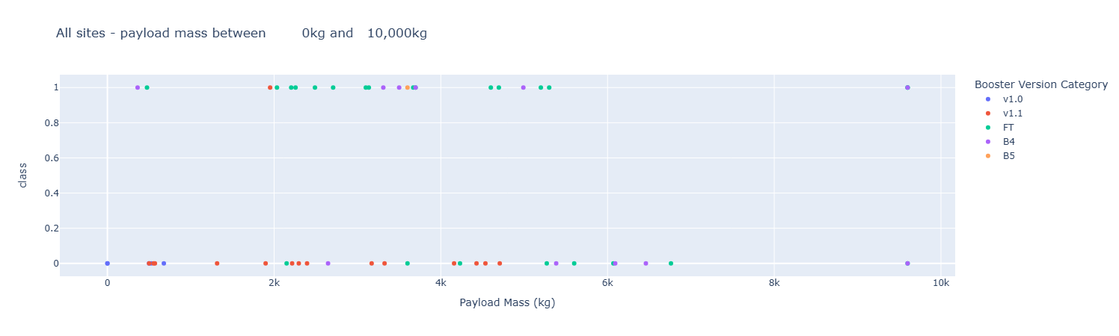
Payload Mass Scatter Plot

Slide 31

Section 5

Slide 32
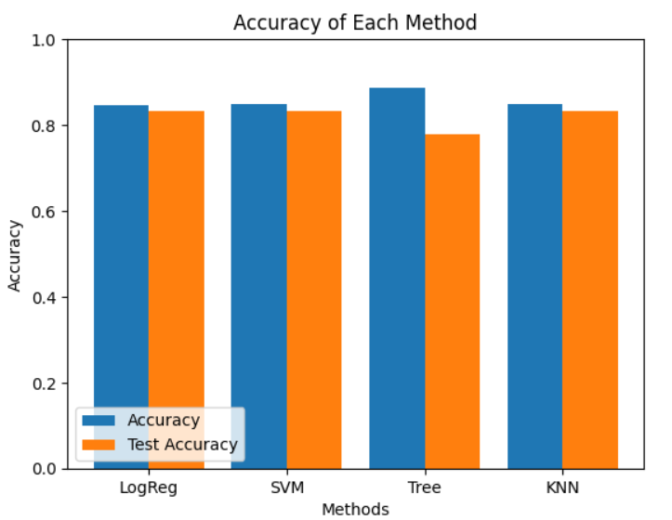
Classification Accuracy

Slide 33
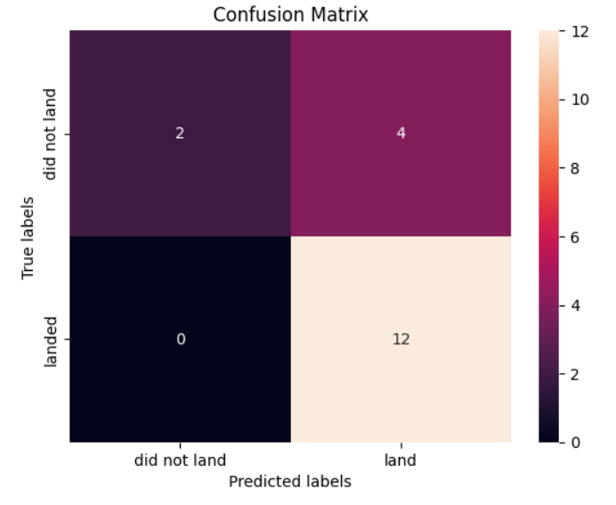
Confusion Matrix

Slide 34
Conclusions
Different data sources were analyzed, refining conclusions along the process;
The best launch site is KSC LC-39A;
Launches above 7,000 kg are less risky;
Although most of mission outcomes are successful, successful landing outcomes seem to improve over time, according the evolution of processes and rockets;
Decision Tree Classifier can be used to predict successful landings and increase profits

Slide 35
Appendix
Github Repo: https://github.com/umangdobhal/Applied-Data-Science-Capstone

Slide 36


Slide 37
Applied Data Science Capstone Project
Umang Dobhal 22 July 2024

Slide 38
Outline
Executive Summary
Introduction
Methodology
Results
Conclusion
Appendix

Slide 39
Executive Summary
Summary of methodologies:
- Data Collection: Web Scraping and SpaceX API
- EDA: Data Wrangling, Data Visualization, Interactive Visual Analytics
- Machine Learning Prediction
Summary of Results:
- Data collected from public sources
- EDA identified key features for launch success
- Best model identified for predicting successful launches

Slide 40
Introduction
Project Background and Context
Objective: Evaluate the viability of SpaceY to compete with SpaceX
Key Questions:
- Estimating total launch costs
- Identifying best launch sites

Slide 41
Methodology: Data Collection
Data collection methods:
- SpaceX API
- Web Scraping
Flowchart of SpaceX API calls
Example URLs and GitHub links for reference notebooks

Slide 42
Methodology: Data Wrangling
Data processing steps
Flowchart of data wrangling process
GitHub link to data wrangling notebook

Slide 43
Methodology: EDA with Data Visualization
Key charts and why they were used:
- Payload Mass vs. Flight Number
- Launch Site vs. Flight Number
GitHub link to EDA with data visualization notebook

Slide 44
Methodology: EDA with SQL
SQL queries performed and their purpose:
- Unique launch sites
- Total payload mass by NASA boosters
GitHub link to SQL queries notebook

Slide 45
Methodology: Build an Interactive Map with Folium
Map objects used and their purpose:
- Markers
- Circles
- Lines
GitHub link to Folium map notebook

Slide 46
Methodology: Build a Dashboard with Plotly Dash
Plots and interactions added to the dashboard:
- Launch success count pie chart
- Payload vs. Launch Outcome scatter plot
GitHub link to Plotly Dash app

Slide 47
Methodology: Predictive Analysis (Classification)
Model development process:
- Models compared: Logistic Regression, SVM, Decision Tree, KNN
GitHub link to machine learning prediction notebook

Slide 48
Results: EDA
Key findings from EDA:
- Average payload of F9 v1.1 booster
- First successful ground landing date

Slide 49
Results: Interactive Analytics
Insights from interactive maps and dashboards:
- Best launch site
- Payload success rates

Slide 50
Results: Predictive Analysis
Best performing model: Decision Tree Classifier with over 87% accuracy
Confusion matrix of Decision Tree Classifier

Slide 51
Conclusion
Summary of key findings:
- Best launch site: KSC LC-39A
- Insights on payload success rates
- Recommendation: Use Decision Tree Classifier for predicting successful landings

Slide 52
Appendix
Additional assets: Python code snippets, SQL queries, charts, notebook outputs

